Slide 1

PULSE-LEAD PEAK DETECTION
PULSE-LEAD PEAK DETECTION
USEN

Slide 2
INTRODUCTION
01
For what kind of problem
METHODOLOGY
02
Innovation approach for the goal
RESULT
03
Performance of model detection
PROSPECT
04
Future improvement of this method

Slide 3


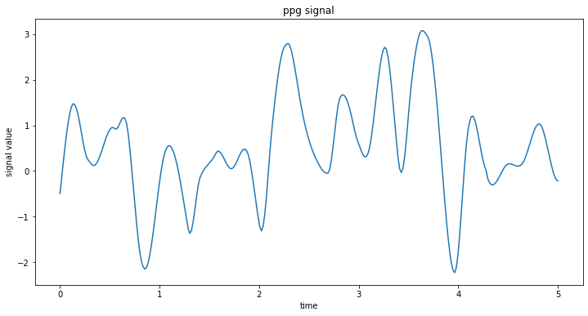
Introduction
Motivation
Finding peaks is simple, but which of them are caused by pulse?
If we can eliminate the peaks caused by noise, much valuable information can be gained

Slide 4

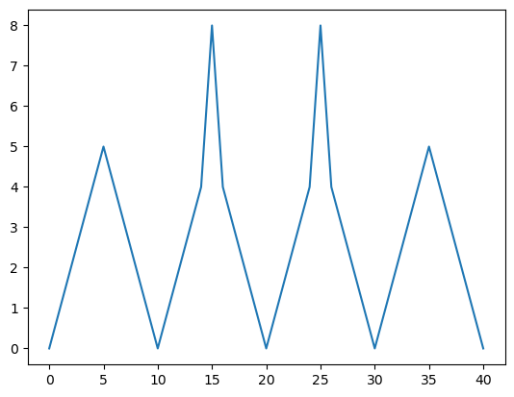
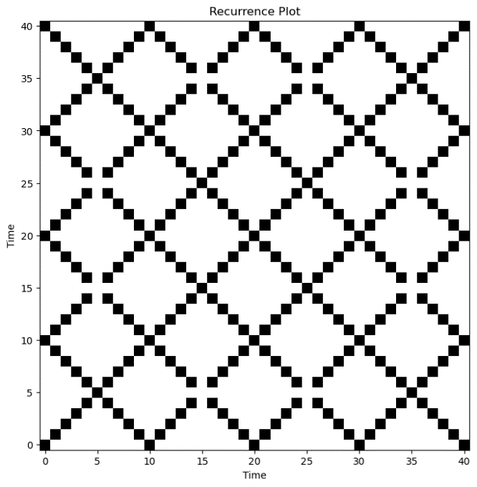
Introduction
Recurrence Plot (RP)
Signal
When time=15 & time=25, signal have the same signal value. This is called a recurrence.
Then on recurrence plot, asset black points on (15 , 25) and (25 , 15)
In punctilious definition, a recurrence does not require exactly same signal value, being similar is also regarded as a recurrence
Recurrence Plot

Slide 5
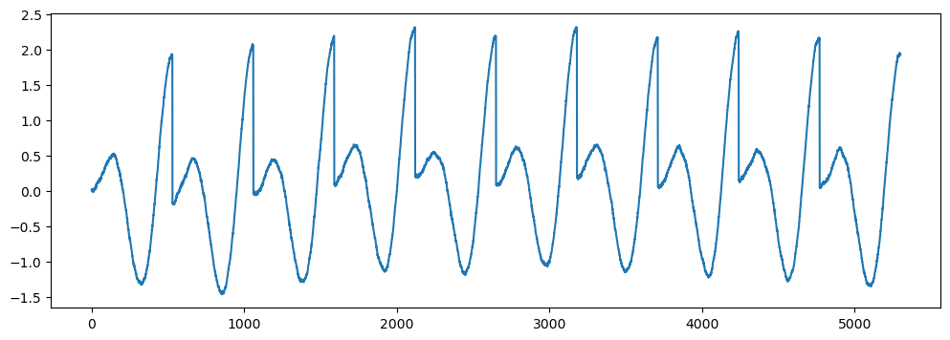
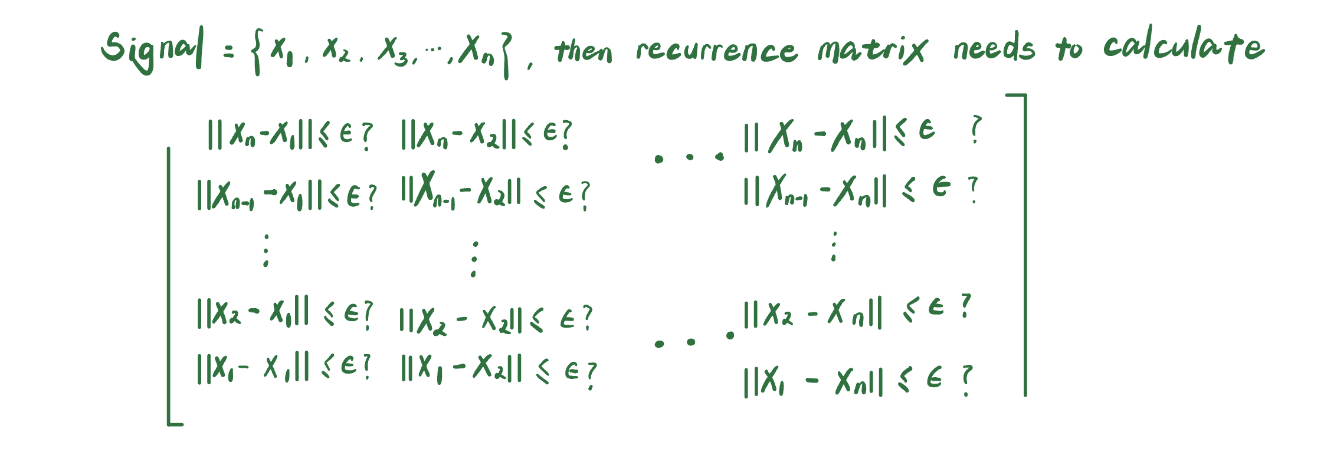
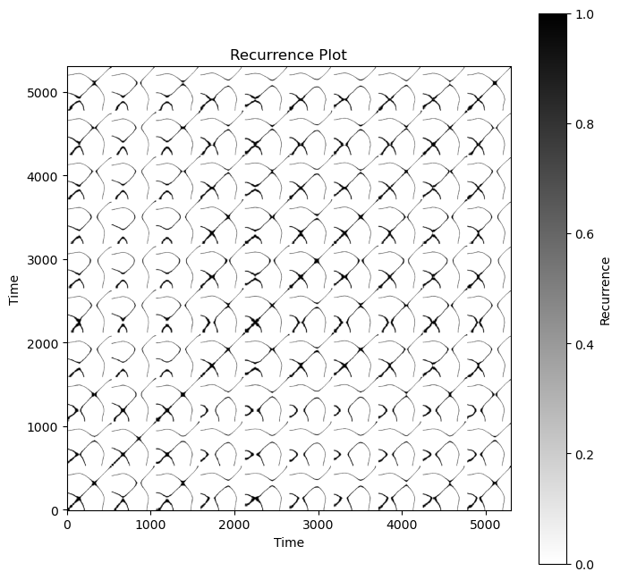
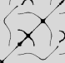

Introduction
Recurrence Plot
Despite the tedious definition, a RP can be draw by implement the logic matrix below
Example of RP based on PPG signal
||A - B|| : Euclidean distance between A and B

Slide 6
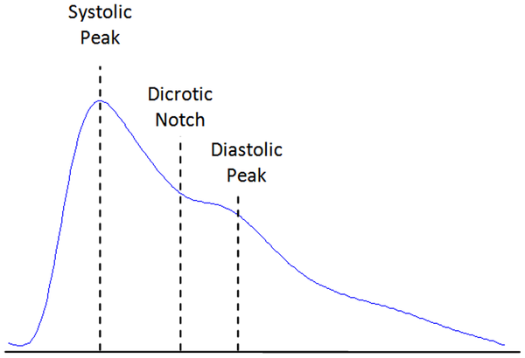
Introduction
Crossbow
The “crossbow” from RP indicates the information of one pulse wave
End of one pulse wave
Systolic Peak
Diastolic Peak

Slide 7

Methodology
Overview
Flowsheet of the Project
Noise-added Training Data
Algorithm 1
RP
CNN Training
Algorithm
Algorithm 0
Label
Training Data
Algorithm 2
Noise-added Testing Data
Algorithm 1
RP
Predictive Model
Algorithm 0
Testing Data
Algorithm 2
Label
Comparison
Estimation

Slide 8
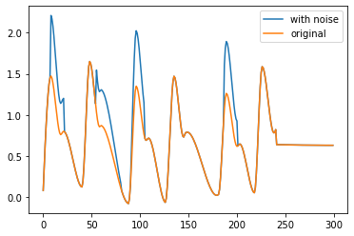
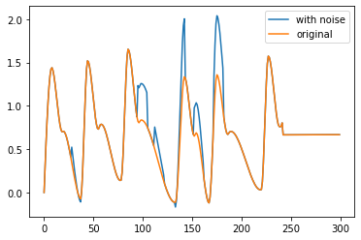
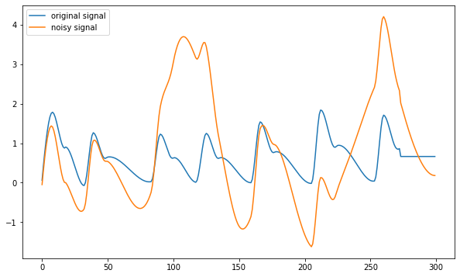
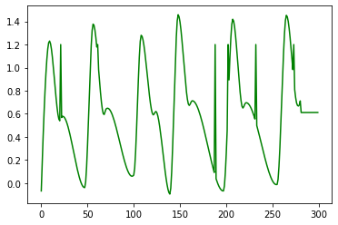
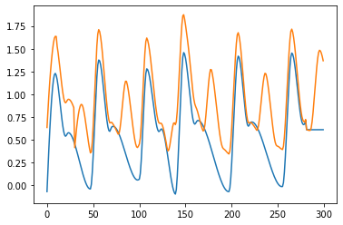
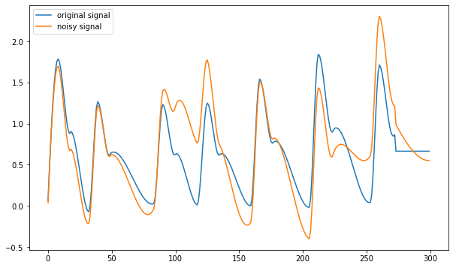
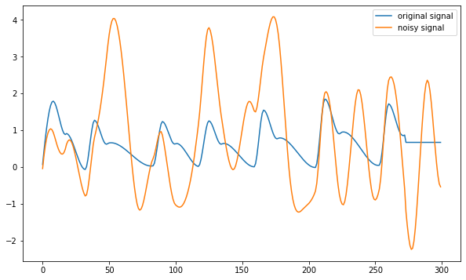
Methodology
Algorithm 0
Adding Noise into Data
Goal is adding fake peaks into signal
Eventually the noise level can be controlled by 2 parameters
Frequency of Noise
Amplitude of Noise
higher amplitude
higher frequency

Slide 9
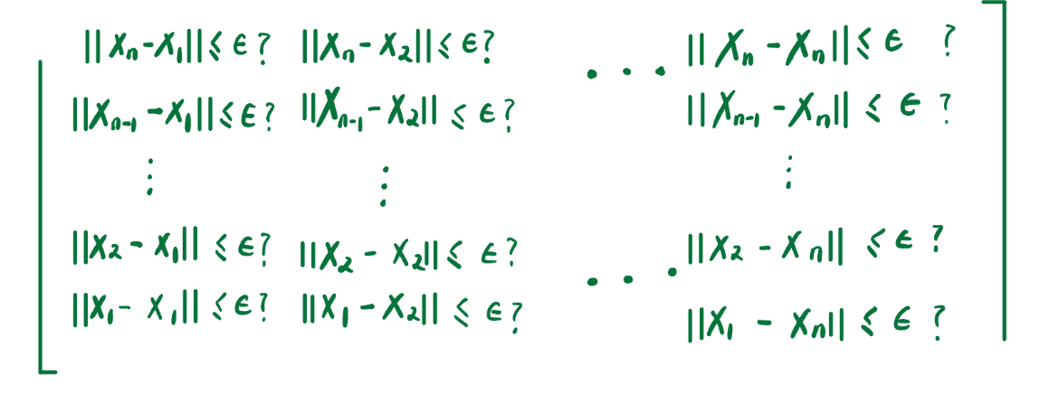


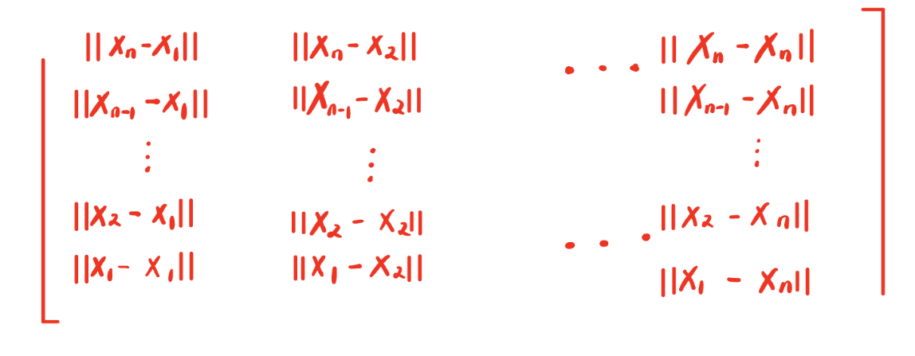

Methodology
Algorithm 1
From Signal to RP
Recurrence plot has 2 different forms.
Form A: composed by 0&1, only contains black points and white blank
Form B: composed by absolute distance, exists as grayscale image
Form A
Form B

Slide 10
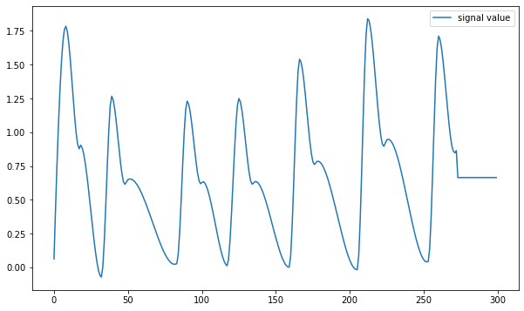
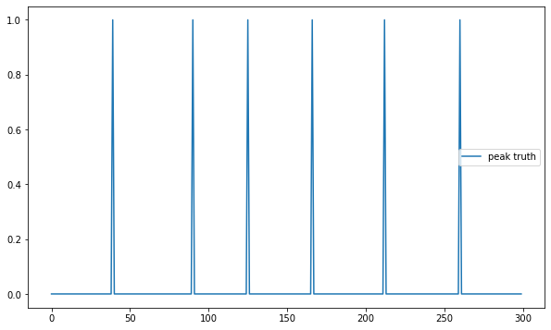
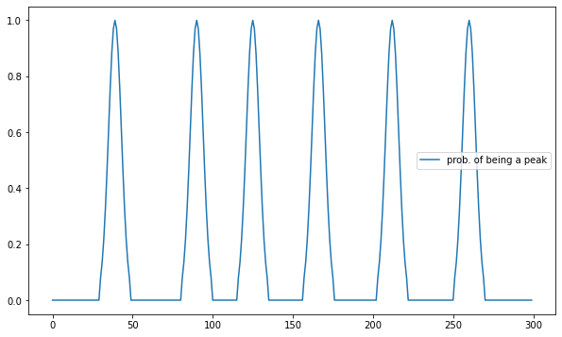
Methodology
Algorithm 2
A. Naïve Method
Data
signal value
Step 1: record precise peak position
Peak Truth is a binary array in the form of [0,0,0,1,0,0,0,0,1,0,…] (lack of information)
Peak Truth
is peak or not
Step 2: assign weights to points near the peak
Label provides information on the region where the peak is located.
Label
probability of being a peak

Slide 11
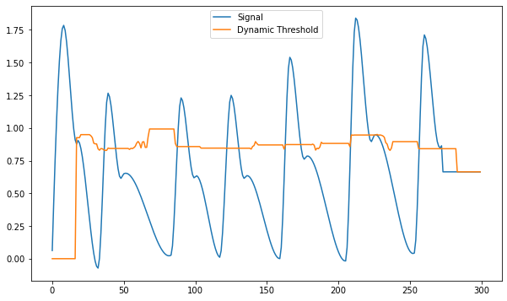
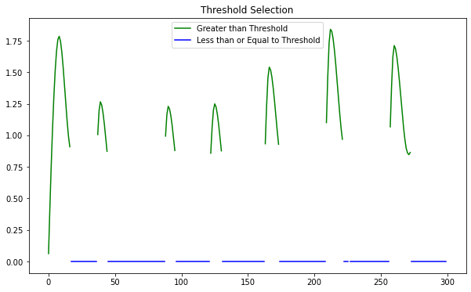
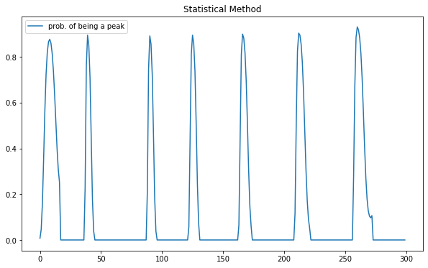
Methodology
Algorithm 2
B. Statistical Method
Data
signal value
Step 1: Use a sliding window to calculate a dynamic threshold
Based on statistical hypothesis testing, points above the threshold have high chance to be a peak point
Selected points are peak-related points
Peak-related Regions
points above threshold
Step 2: Normalize peak-related regions
Squeeze values into [0,1] by cumulative density function of normal distribution
Label
probability of being a peak

Slide 12
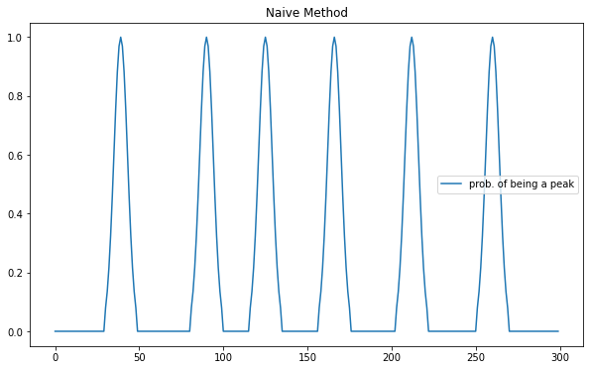
Methodology
Algorithm 2
Naïve vs Statistical
Statistical method is well-supported by theories. And it takes the width of pulse wave into considerration
But statistical method still requires future improvements since sometimes it mix up diastolic peak & systolic peak

Slide 13
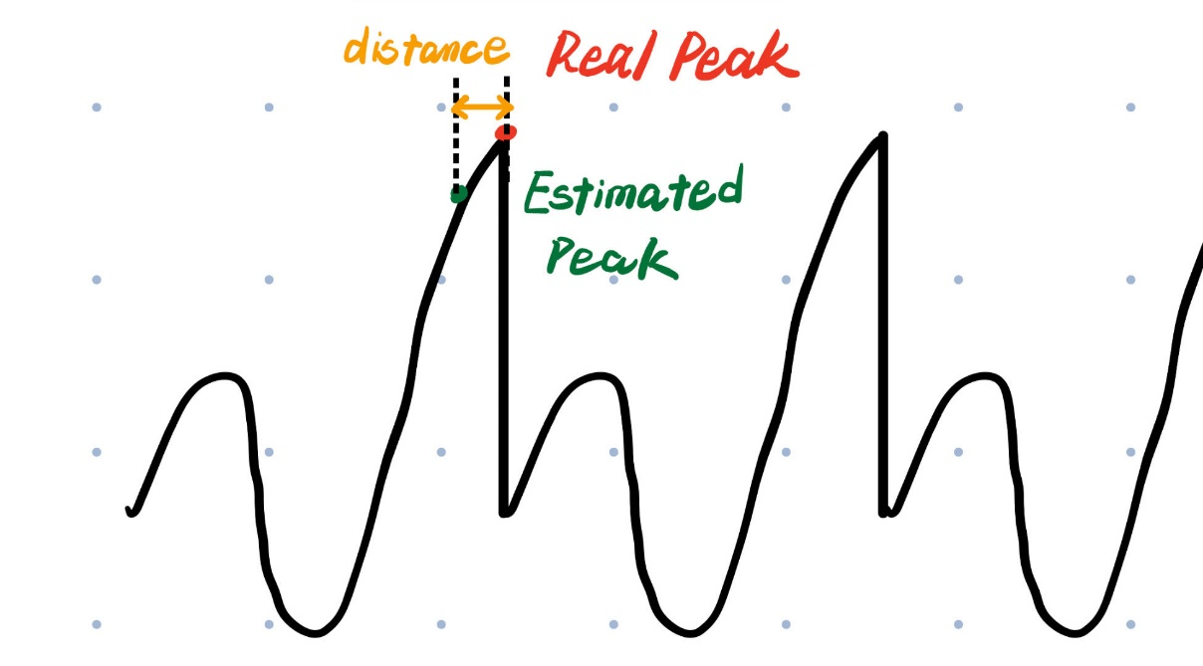

Result
Evaluation Standard
Distance Error: the distance between real peak and estimated peak
Use the Mean Distance Error with better interpretation: average accuracy of estimated peak
Error Rate: the percentage of model incorrectly predict the number of peaks

Slide 14
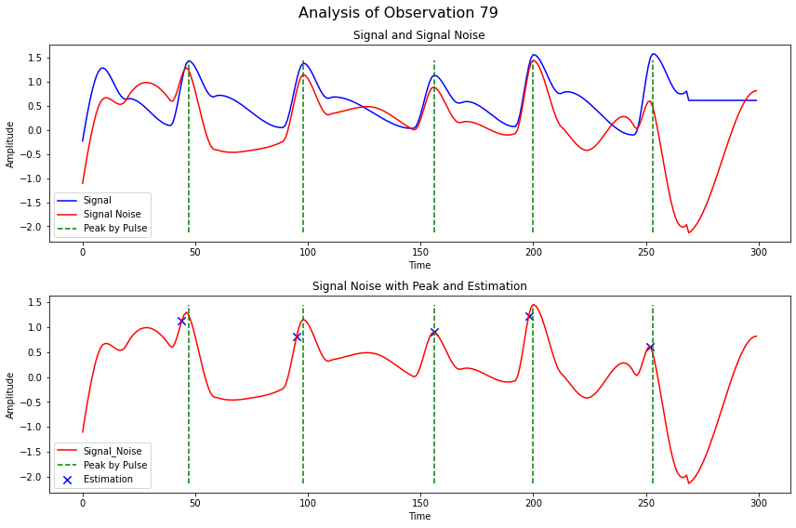
Result
Feasibility Test
Mean Distance Error = 0.23
Error Rate = 1/500
Noise Level: Amplitude=3.5 Frequency=1.3 (Median Level)

Slide 15
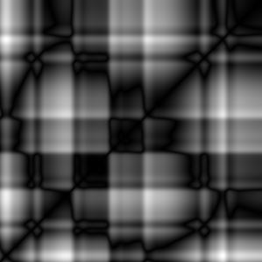

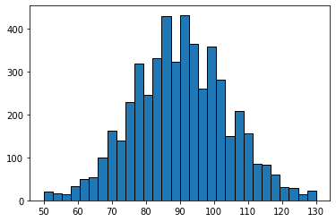

Result
Grid Search
Noise level can be controlled by 2 parameters
Frequency of Noise
Amplitude of Noise
Try different combinations within the reasonable range and check model performance
higher amplitude
Data scale:
Sample size = 5000
Testing : Training : Validation = 8:1:1
Sampling rate = 60
Signal duration = 5s
higher frequency

Slide 16
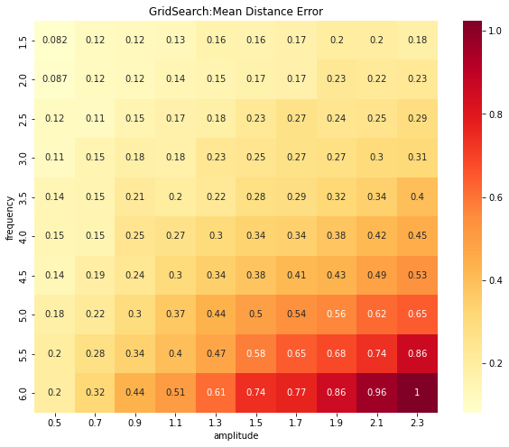
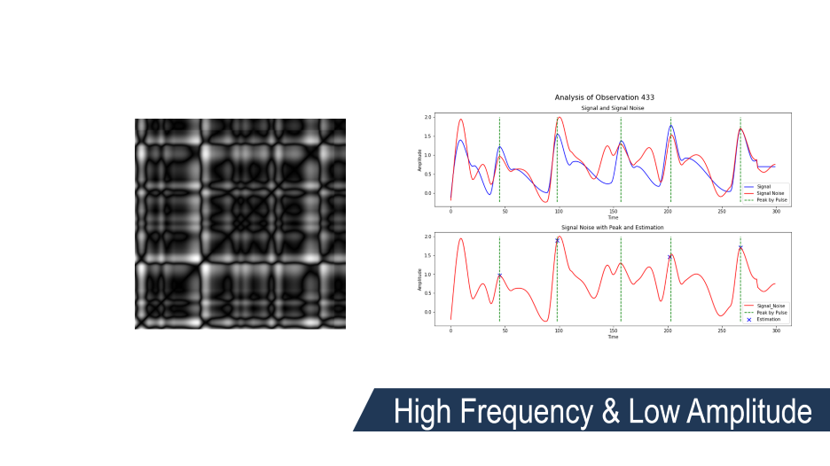
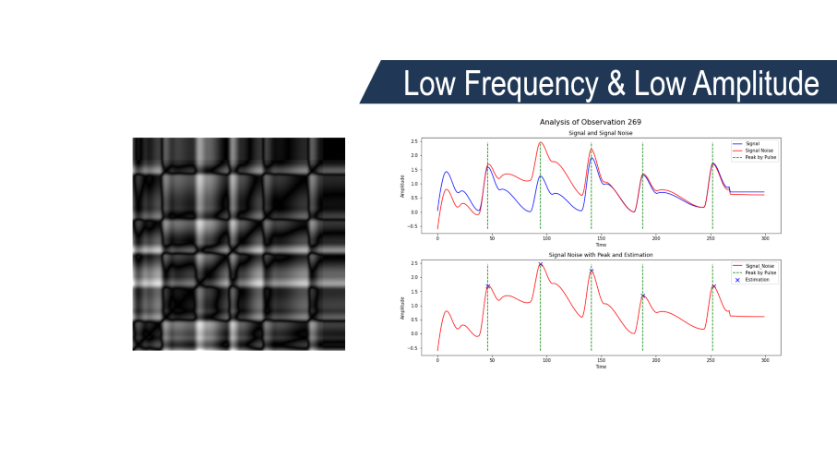
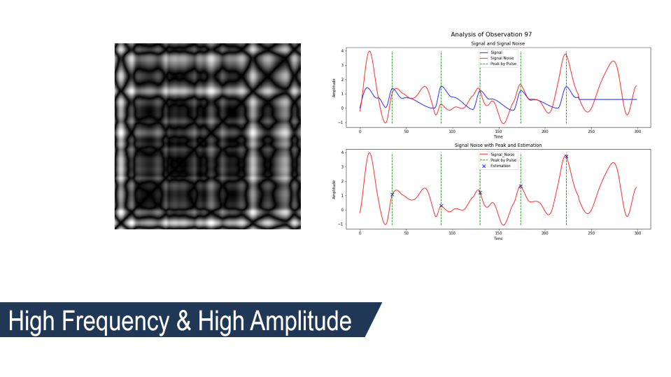
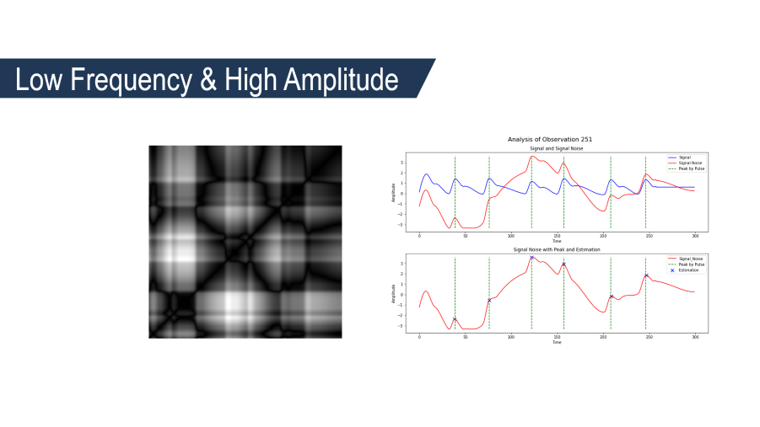
Result
Grid Search

Slide 17
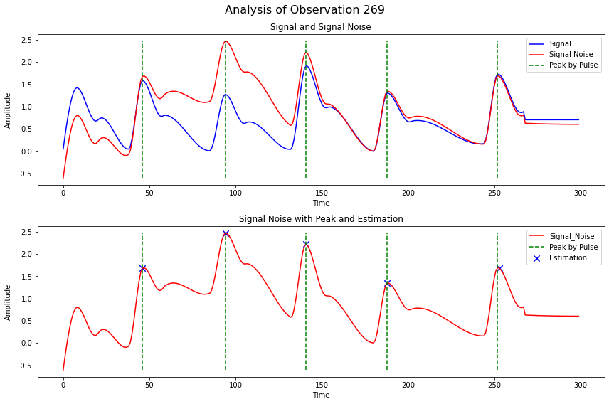

Low Frequency & Low Amplitude

Slide 18
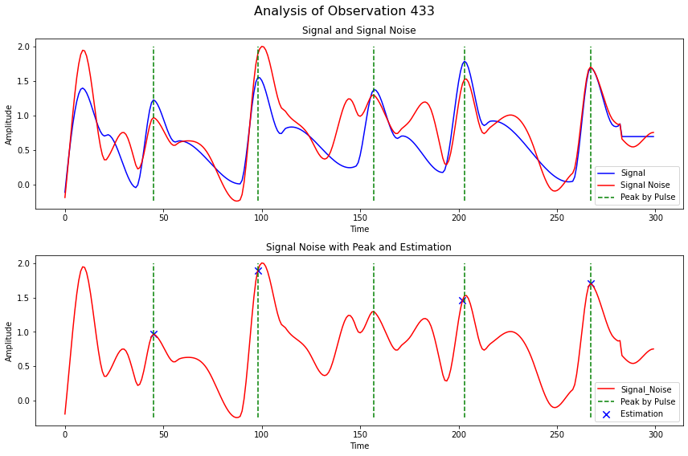

High Frequency & Low Amplitude

Slide 19
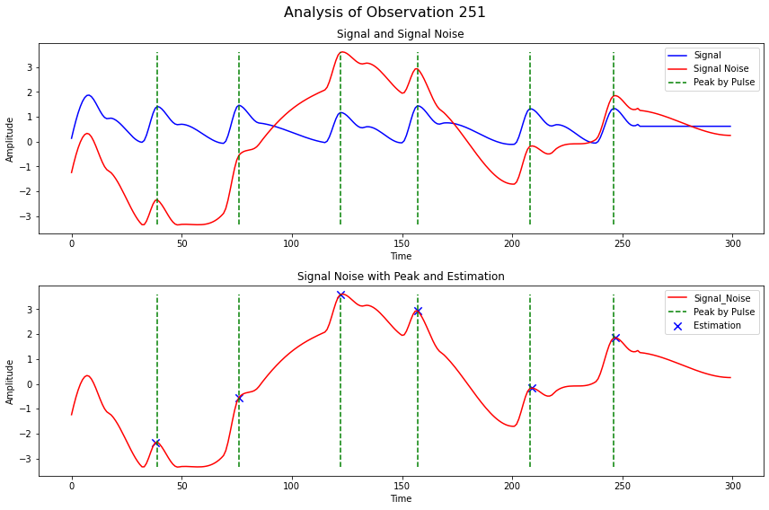

Low Frequency & High Amplitude

Slide 20
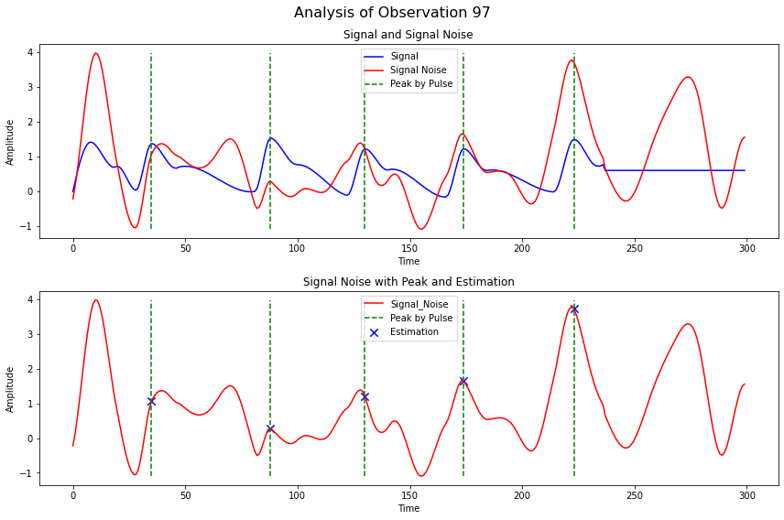
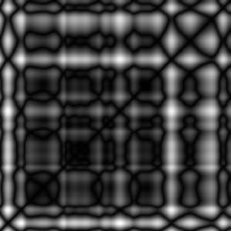
High Frequency & High Amplitude

Slide 21
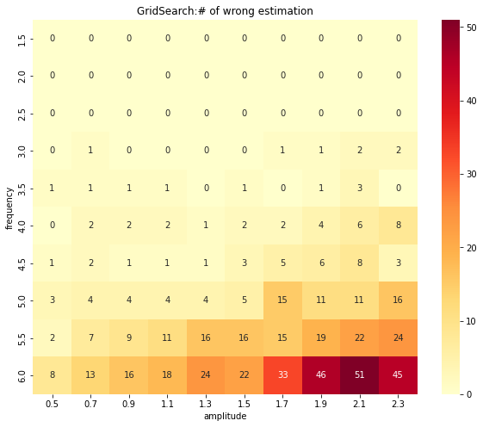
Result
Grid Search
Rate is too low, so just use the cumulative sum of wrong estimation count

Slide 22
PROSPECT
Summary
Noise-added Training Data
Algorithm 1
RP
CNN Training
Algorithm
Algorithm 0
Label
Training Data
Algorithm 2
Noise-added Testing Data
Algorithm 1
RP
Predictive Model
Algorithm 0
Testing Data
Algorithm 2
Label
Comparison
Estimation

Slide 23
PROSPECT
Future Improvement
Limitation of synthetic data and synthetic noise.
Implementation of statistical method for labeling method
More elaborate model architecture
Fitness for higher dimensional data(RGB signal)
Noise-added Training Data
Algorithm 1
RP
CNN Training
Algorithm
Algorithm 0
Label
Training Data
Algorithm 2
Noise-added Testing Data
Algorithm 1
RP
Predictive Model
Algorithm 0
Testing Data
Algorithm 2
Label
Comparison
Estimation

Slide 24
- THANK YOU -

